Slide 1
Inheritance
The capability of a class to derive properties and characteristics from another class is called Inheritance.
Sub Class: The class that inherits properties from another class is called Sub class or Derived Class.
Super Class:The class whose properties are inherited by sub class is called Base Class or Super class.
class Animal {
// eat() function
// sleep() function
};
class Dog : public Animal {
// bark() function
};

Slide 3
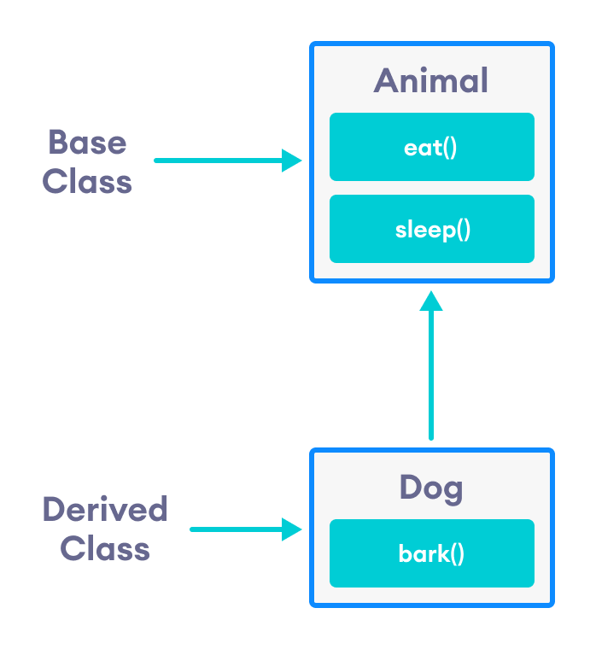

Slide 4
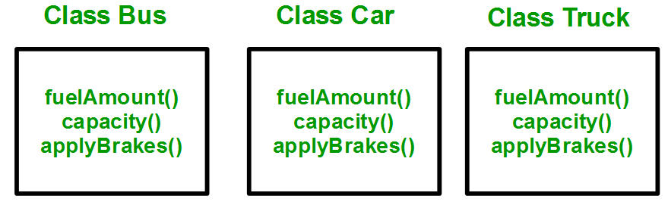
Why and when to use inheritance?
Consider a group of vehicles. You need to create classes for Bus, Car and Truck. The methods fuelAmount(), capacity(), applyBrakes() will be same for all of the three classes.
If we create these classes avoiding inheritance then we have to write all of these functions in each of the three classes as shown in below figure:

Slide 5
Why and when to use inheritance?
You can clearly see that above process results in duplication of same code 3 times.
This increases the chances of error and data redundancy. To avoid this type of situation, inheritance is used.
If we create a class Vehicle and write these three functions in it and inherit the rest of the classes from the vehicle class, then we can simply avoid the duplication of data and increase re-usability.

Slide 6
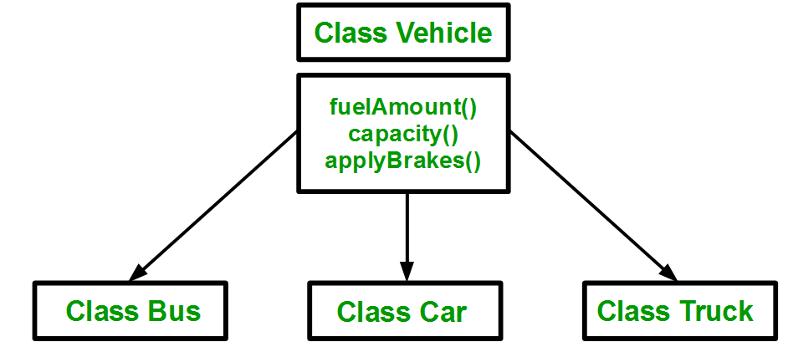
Using inheritance, we have to write the functions only one time instead of three times as we have inherited rest of the three classes from base class(Vehicle).

Slide 7
Inheritance is an is-a relationship. We use inheritance only if an is-a relationship is present between the two classes.
Here are some examples:
A car is a vehicle.
Orange is a fruit.
A surgeon is a doctor.
A dog is an animal.

Slide 8
Implementing inheritance in C++
class subclass_name : access_mode base_class_name
{
//body of subclass
};
Here, subclass_name is the name of the sub class, access_mode is the mode in which you want to inherit this sub class for example: public, private etc. and base_class_name is the name of the base class from which you want to inherit the sub class.
Note: A derived class doesn’t inherit access to private data members.

Slide 9
using namespace std;
//Base class
class Parent
{
public:
int id_p;
};
// Sub class inheriting from Base Class(Parent)
class Child : public Parent
{
public:
int id_c;
};
//main function
int main()
{
Child obj1;
// An object of class child has all data members
// and member functions of class parent
obj1.id_c = 7;
obj1.id_p = 91;
cout << "Child id is " << obj1.id_c << endl;
cout << "Parent id is " << obj1.id_p << endl;
return 0;
}
Child id is 7
Parent id is 91
In the above program the ‘Child’ class is publicly inherited from the ‘Parent’ class so the public data members of the class ‘Parent’ will also be inherited by the class ‘Child’.

Slide 10
Modes of Inheritance
Public mode: If we derive a sub class from a public base class. Then the public member of the base class will become public in the derived class and protected members of the base class will become protected in derived class.
Protected mode: If we derive a sub class from a Protected base class. Then both public member and protected members of the base class will become protected in derived class.
Private mode: If we derive a sub class from a Private base class. Then both public member and protected members of the base class will become Private in derived class.
The private members in the base class cannot be directly accessed in the derived class, while protected members can be directly accessed.

Slide 11
class A
{
public:
int x;
protected:
int y;
private:
int z;
};
class B : public A
{
// x is public
// y is protected
// z is not accessible from B
};
class C : protected A
{
// x is protected
// y is protected
// z is not accessible from C
};
class D : private A // 'private' is default for classes
{
// x is private
// y is private
// z is not accessible from D
};

Slide 12
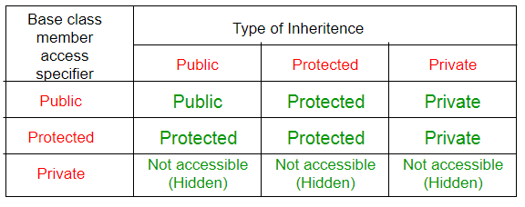

Slide 13
class Declaration
{
private:
int a;
public:
int b;
protected:
int c;
public:
void show()
{
a=10;
b=20;
c=30;
//Every members can be access here, same class
cout<<"\nAccessing variable within the class"<<endl;
cout<<"Value of a: "<<a<<endl;
cout<<"Value of b: "<<b<<endl;
cout<<"Value of c: "<<c<<endl;
}
};
class Sub_class:public Declaration
{
public:
}
void show()
{
b=5;
c=6;
cout<<"\nAccessing variable in sub the class"<<endl;
//cout<<"Value of a: "<<a<<endl;
//b is public so it is accessible any where
cout<<"Value of b: "<<b<<endl;
//'c' is declared as protected, so it is accessible in sub class
cout<<"Value of c: "<<c<<endl;
}
};
void main()
{
Declaration d; // create object
d.show();
Sub_class s; // create object
s.show(); // Sub class show() function
cout<<"\nAccessing variable outside the class"<<endl;
//'a' cannot be accessed as it is private
//cout<<"value of a: "<<d.a<<endl;
//'b' is public as can be accessed from any where
cout<<"value of b: "<<d.b<<endl;
//'c' is protected and cannot be accesed here
//cout<<"value of c: "<<d.c<<endl;

Slide 14
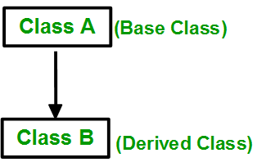
Single Inheritance

Slide 15
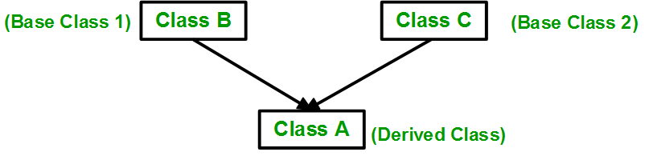
Multiple Inheritance:

Slide 16
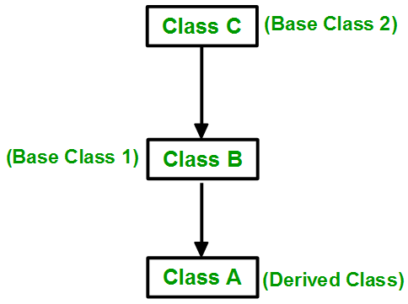
Multilevel Inheritance

Slide 17
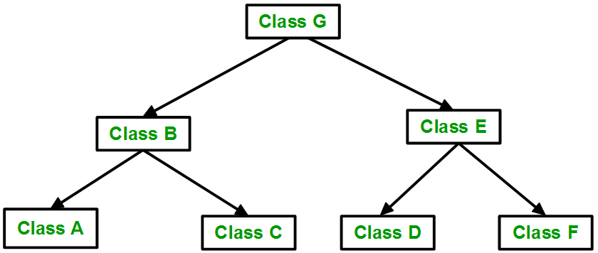
Hierarchical Inheritance:

Slide 18
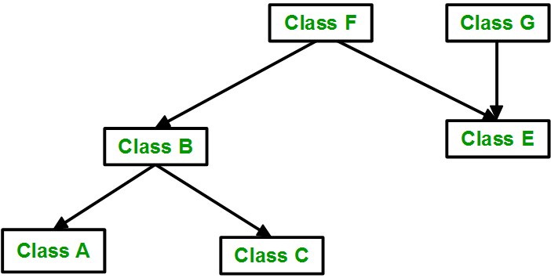
Hybrid (Virtual) Inheritance:

Slide 19
Multipath inheritance:

Slide 20
Diamond Problem from multiple inheritance:
#include<iostream>
using namespace std;
class A //base class A with constructor and destructor
{
public:
A() { cout << "class A::Constructor" << endl; }
~A() { cout << "class A::Destructor" << endl; }
};
class B //base class B with constructor and destructor
{
public:
B() { cout << "class B::Constructor" << endl; }
~B() { cout << "class B::Destructor" << endl; }
};
class C: public B, public A //derived class C inherits class A and then class B (note the order)
{
public:
C() { cout << "class C::Constructor" << endl; }
~C() { cout << "class C::Destructor" << endl; }
};
int main(){
C c;
}
Output:
class B::Constructor
class A::Constructor
class C::Constructor
class C::Destructor
class A::Destructor
class B::Destructor

Slide 21
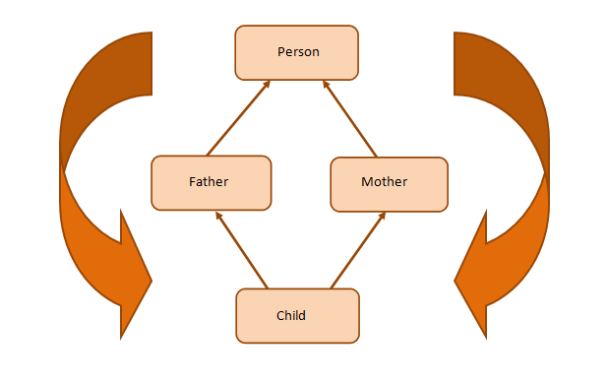
Diamond Problem from multiple inheritance:
The Diamond Problem occurs when a child class inherits from two parent classes who both share a common grandparent class. This is illustrated in the diagram below:
Here, we have a class Child inheriting from classes Father and Mother. These two classes, in turn, inherit the class Person because both Father and Mother are Person.

Slide 22
Diamond Problem from multiple inheritance:
Class Child inherits the traits of class Person twice—once from Father and again from Mother. This gives rise to ambiguity since the compiler fails to understand which way to go.
#include<iostream> using namespace std; class Person { public: Person(int x) { cout << "Person called" << endl; } }; class Father : public Person { public: Father(int x):Person(x) { cout << "Father called" << endl; } }; class Mother : public Person { public: Mother(int x):Person(x) { cout << "Mother called" << endl; } };
Person called Father called Person called Mother called Child called
class Child : public Father, public Mother { public: Child(int x):Mother(x), Father(x) { cout << "Child called" << endl; } }; int main() { Child child(30); }

Slide 23
Now you can see the ambiguity here. The Person class constructor is called twice: once when the Father class object is created and next when the Mother class object is created. The properties of the Person class are inherited twice, giving rise to ambiguity.
Fix Diamond Problem:
The solution to the diamond problem is to use the virtual keyword. We make the two parent classes (who inherit from the same grandparent class) into virtual classes in order to avoid two copies of the grandparent class in the child class.

Slide 24
Diamond Problem from multiple inheritance:
Class Child inherits the traits of class Person twice—once from Father and again from Mother. This gives rise to ambiguity since the compiler fails to understand which way to go.
#include<iostream> using namespace std; class Person { public: Person(int x) { cout << "Person called" << endl; } }; class Father : virtual public Person { public: Father(int x):Person(x) { cout << "Father called" << endl; } }; class Mother :virtual public Person { public: Mother(int x):Person(x) { cout << "Mother called" << endl; } };
Person called Father called Mother called Child called
class Child : public Father, public Mother { public: Child(int x):Mother(x), Father(x) { cout << "Child called" << endl; } }; int main() { Child child(30); }

Slide 25
Redefining (Overriding) Member Functions of the Base Class
To redefine (override) a public member function of a base class
Corresponding function in the derived class must have the same name, number, and types of parameters. Redefined
If the function has a different signature, this would be function overloading.

Slide 26
Redefining (Overriding) Member Functions of the Base Class (continued)
If derived class overrides a public member function of the base class, then to call the base class function, specify:
Name of the base class
Scope resolution operator (::)
Function name with the appropriate parameter list

Slide 27
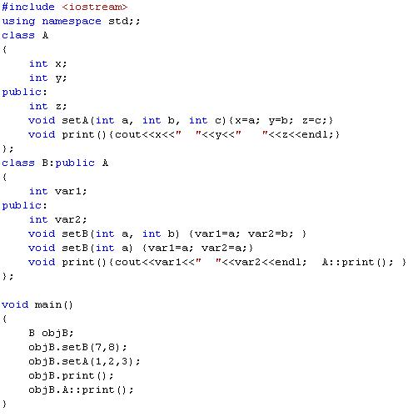
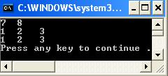
var1
var2
z
x
y
print
setB
A::print
setA

Slide 28
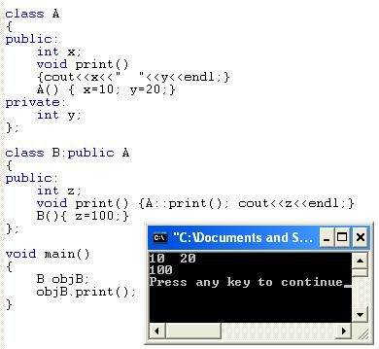
Example

Slide 29
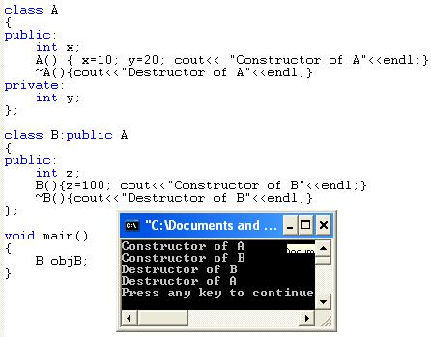
Example

Slide 30
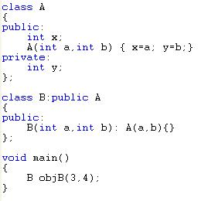
Initialization List and Inheritance
objB
A
3
x
4
y
Initialization list goes with constructor of derived class and uses class name to pass parameters to base class constructor.

Slide 31
A publishing company that markets both books, Tape/drive (audiocassette and Videocassette) versions of its works. Create a class publication that stores the title (a string) and price (type float) of a publication. From this class derive two classes: book, which adds a page count (type int), and tape, which adds a playing time in minutes (type float). Each of these three classes should have a getdata() function to get its data from the user at the keyboard, and a putdata() function to display its data. Write a main() program to test the book and tape/drive classes by creating instances of them, asking the user to fill in data with getdata(), and then displaying the data with putdata() as per the order based on the user choice either playing time or number of pages

Slide 32
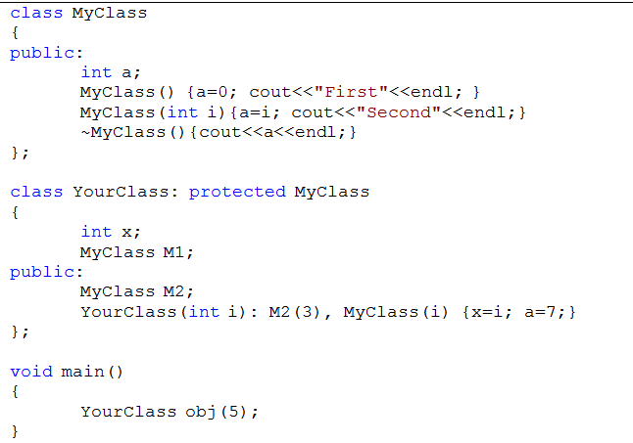
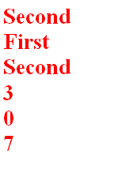

Slide 33
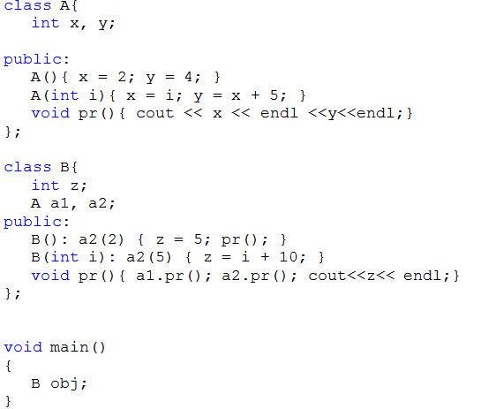


Slide 34
